Slide 1






REAL-TIME SAFETY AND FAULT INJECTION
Prepared by A. Bakke, B. Thapa, H. Hassan and revised by Stefano Di Carlo, Alessandro Savino, Alessio Carpegna and Cristiano Chenet

Slide 2
MOTIVATION
REAL-TIME SAFETY CRITICAL APPLICATION
DEADLINE MISS -> CATASTROPHIC CONSEQUENCES
POSSIBLE SOURCE -> SINGLE EVENT UPSET (SEU)

Slide 3
SINGLE EVENT UPSET (SEU) AND SOFT ERROR
SEU: ONE SINGLE IONIZING PARTICLE (IONS, ELECTRONS, PHOTONS...) STRIKING A SENSITIVE NODE(e.g., MEMORY CELL: “BIT”) IN A LIVE MICRO-ELECTRONIC DEVICE CAUSING CHANGE OF STATE (e.g., “BITFLIP”)
In 2003 in Schaerbeek, Belgium, an SEU was responsible for giving a candidate in an election an extra 4,096 votes.
In 2013, during the speed run of Super Mario 64 on Nintendo 64 console, a bit flip on the least significant bit of the most significant byte of Mario height value caused Mario to warp to the upper floor.
RESULTING ERROR DUE TO SEU ALSO CALLED -> “SOFT ERROR”
Ian Johnston (17 February 2017). "Cosmic particles can change elections and cause planes to fall through the sky, scientists warn“
How An Ionizing Particle From Outer Space Helped A Mario Speedrunner Save Time

Slide 4
GOAL
Implementation of a monitoring technique for Soft Error.
Implementation of recovery technique from the soft error.
Soft error fault injection mechanism to test.

Slide 5
INSPIRATION FOR POSSIBLE SOLUTION
A Novel Method for Online Detection of Faults Affecting Execution-Time in Multicore-Based Systems
ACM Transactions on Embedded Computing SystemsVolume 16Issue 4Article No.: 94pp 1–19https://doi.org/10.1145/3063313
Authors: Stefano Esposito, Massimo Violante, Marco Sozzi, Marco Terrone, Massimo Traversone

Slide 6
INTERFERENCE DETECTION BASED ON PERFORMANCE MONITORS
BOUNDED INTERFERENCE APPROACH
TWO PHASES: OFFLINE AND ONLINE
OFFLINE:
DATA PROFILING AND WCET ESTIMATION
THRESHOLD COMPUTATION -> BOUNDING A TASK WITHIN THRESHOLDS
ONLINE:
SAFETY-NET USING PERFORMANCE COUNTER
EVALUATE: COMPARE MEASUREMENT TO THRESHOLDS
DETECT AND RECOVER AS NECESSARY

Slide 7
STEPS (OFFLINE)
METRIC SELECTION
ANY QUANTITY THAT CAN BE MEASURED AT RUN-TIME AND LIKELY TO BE AFFECTED WHEN INTERFERENCE OCCURS
E.G. CLOCK CYCLE COUNTERS
METRIC CHARACTERIZATION
METRIC OFTEN NON-DETERMINISTIC
MEASURE METRIC AND PROFILE
GATHER SAMPLES AND FIT TO A KNOWN PROBABILITY DENSITY FUNCTION(PDF)
THRESHOLDS DETERMINATION
DETECTION THRESHOLD: INTERFERENCE HAS OCCURRED
WARNING THRESHOLD: INTERFERENCE MIGHT HAVE OCCURRED
NEED FURTHER OBSERVATION
IF OBSERVED CONSECUTIVELY FOR SOME NUMBER OF TIMES, INTERFERENCE HAS OCCURRED

Slide 8
STEPS (ONLINE)
ON-LINE DETECTION
READ PERFORMANCE COUNTER (METRIC)
COMPARE TO THRESHOLDS
IF METRIC ABOVE DETECTION THRESHOLD, RAISE ALARM (CRITICAL)
IF METRIC BETWEEN WARNING THRESHOLD AND DETECTION THRESHOLD FOR $∝$ MEASUREMENTS, RAISE WARNING (NON-CRITICAL)
IF METRIC BETWEEN WARNING THRESHOLD AND DETECTION THRESHOLD FOR ∝ MEASUREMENTS, RAISE WARNING (NON-CRITICAL)
RECOVERY
GRACEFUL DEGRADATION: ALTERNATE SCHEDULING TO ALLOW TASKS TO COMPLETE WITHIN DEADLINE
HARD RECOVERY: SWITCH TO AN AVAILABLE HOT STANDBY SPARE GUARANTEED TO RESTORE FUNCTIONALITY OR AT LEAST AVOID CATASTROPHIC CONSEQUENCE

Slide 9
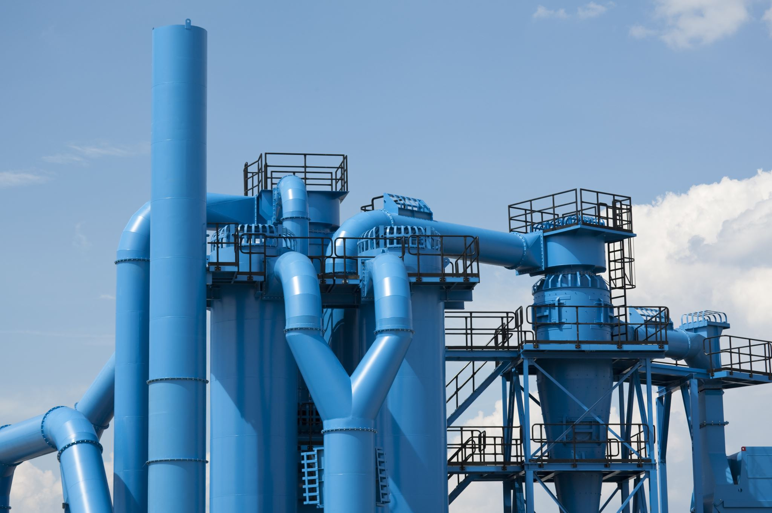
DEMONSTRATION BY REAL-WORLD SIMULATION
REAL-WORLD SYSTEM FOR EASIER UNDERSTANDING
FULL USE OF A POWERFUL BOARD
SYSTEM CHOICE: WATER TOWER SYSTEM

Slide 10
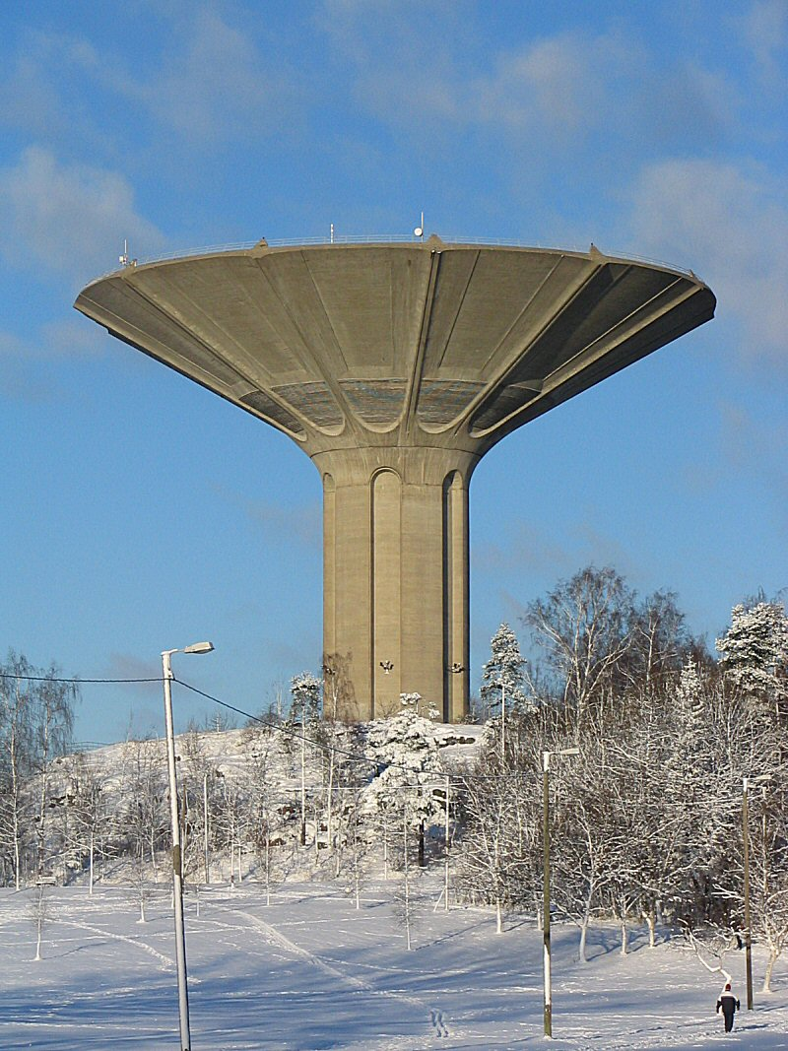
WATER TOWER SYSTEM
A LARGE ELEVATED TANK TO PROVIDE STEADY AND PRESSURIZED WATER TO BUILDINGS
MOST VISIBLE AND MOST COMMON PART OF WATER SUPPLY SYSTEM
WHY?
WATER DEMAND VARIES THROUGHOUT THE DAY
STEADY WATER SUPPLY AND ADEQUATE PRESSURE AND FLOW NECESSARY FOR WATER SUPPLY SYSTEM TO FUNCTION PROPERLY AND CORRECTLY
WATER TOWER ADVANTAGE:
FULFILL PEAK WATER DEMANDS FROM AVERAGE SIZED PUMP(LESS EXPENSIVE)
FULFILL DEMAND DURING POWER OUTAGE
MAINTAIN WATER PRESSURE
Roihuvuori water tower - Helsinki Finland
by Otto-Ville Mikkelä under CC-BY-SA 3.0
Source: Wikipedia https://en.wikipedia.org/wiki/Water_tower#/media/File:Roihuvuori_water_tower_-_Helsinki_Finland.jpg

Slide 11
TYPICAL HOURLY WATER DEMAND

Slide 12
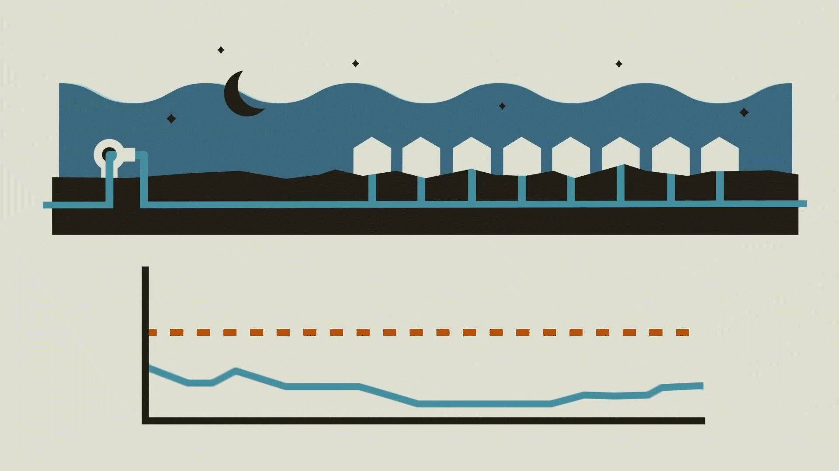
WITHOUT WATER TOWER
“How Water Towers Work" by Practical Engineering https://www.youtube.com/watch?v=yZwfcMSDBHs.

Slide 13
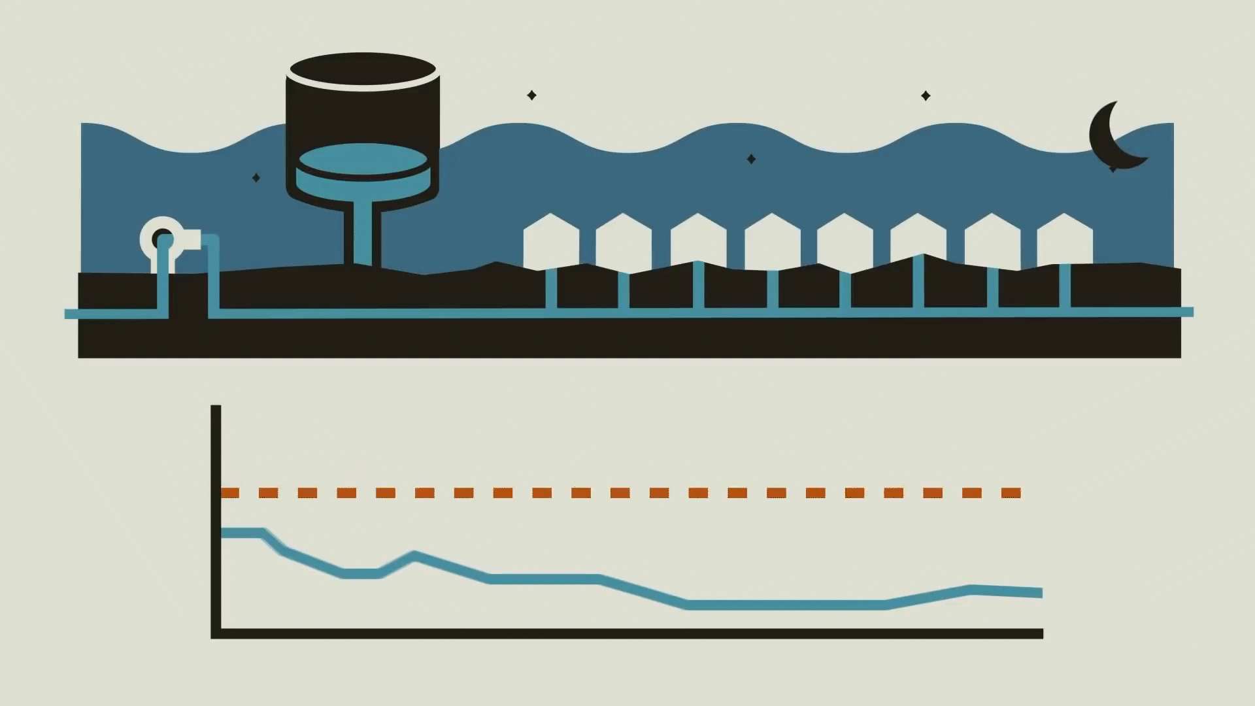
WATER TOWER SYSTEM
“How Water Towers Work" by Practical Engineering https://www.youtube.com/watch?v=yZwfcMSDBHs.

Slide 14
WATER TOWER SYSTEM SIMULATION
Tank fill and drain simulation
hourly update
Pump running at average demand rate when active
Demand varies depending on hour of the day
Rates are in tank-water-level/hour where a level is arbitrary amount of water.

Slide 15
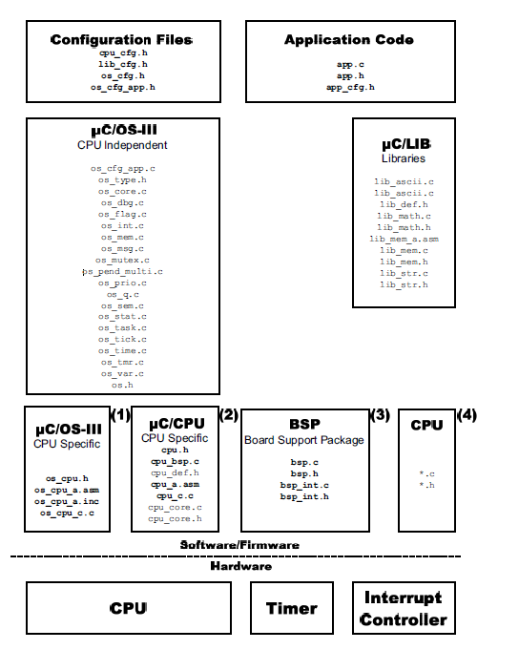
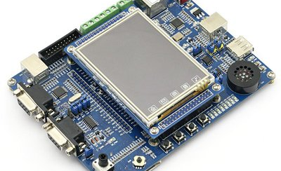

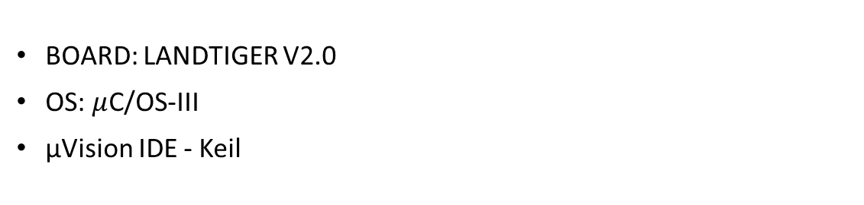
LAB SETUP
BOARD: LANDTIGER V2.0
OS: $μ$C/OS-III
µVision IDE - Keil

Slide 16
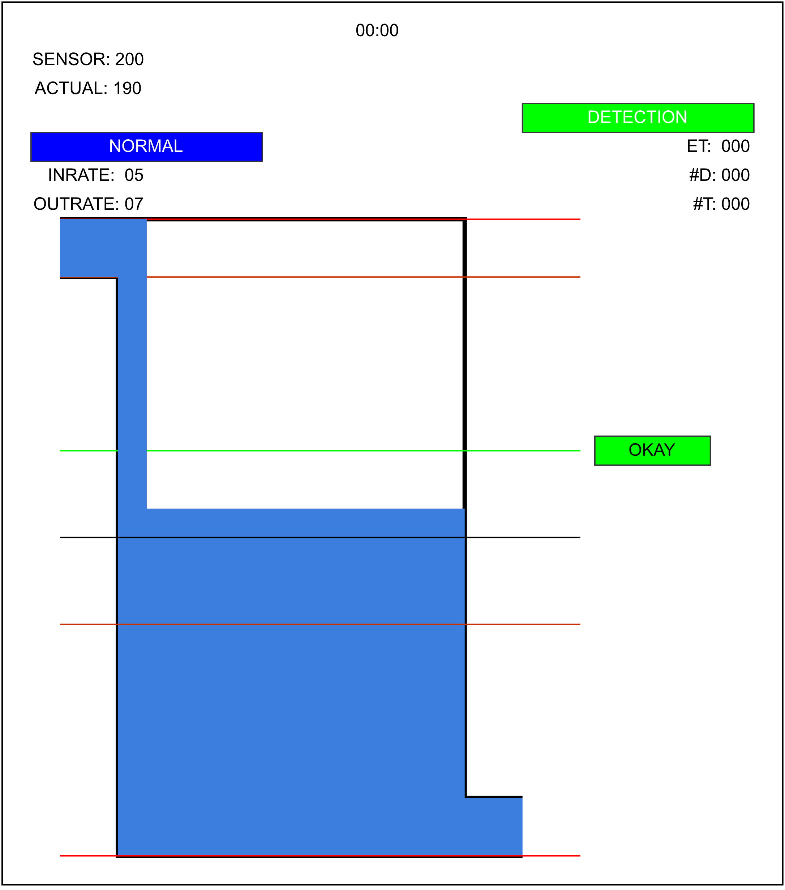
WATER TOWER SYSTEM: GUI
SENSOR READING
ACTUAL WATER LEVEL
INFLOW RATE FROM PUMPS
OUTFLOW RATE DUE TO DEMAND
CONTROLLER MODE:
NORMAL
GRACEFUL DEGRAGATION
HARD RECOVERY
DETECTION : ON/OFF
EXECUTION TIME
NUMBER OF DETECTION
NUMBER OF FAULTS TOLERATED
WATER LEVEL STATUS

Slide 17

WATER TOWER PARAMETERS
AVERAGE OUTFLOW RATE DUE TO DEMAND : 5
DEFAULT INFLOW RATE FROM PUMPS : 5
TANK BOTTOM LEVEL : 310
TANK TOP LEVEL : 120
DESIRED LEVEL : 180
THRESHOLD HIGH TO STOP PUMPS: 180-40=140
THRESHOLD LOW TO START PUMPS: 180+40=220

Slide 18
WATER DEMAND SIMULATION

Slide 19
WATER TOWER SYSTEM:IMPLEMENTATION
EXPLOITING THE FUNCTIONALITY OF REAL TIME OS : UC/OS-III
APP TASK:
LOWEST PRIORITY
MOST FREQUENT USING WHILE(DEF_TRUE) AND NO WAIT
MONITOR BUTTONS -> LOCKS SCHEDULER -> UPDATE GUI -> UNLOCK SCHEDULER -> REPEAT
GUI TASK:
UPDATES HOUR THEREFORE THE WATER DEMAND AND ACTUAL WATER LEVEL
PERIODIC, RUNS AT EACH TICK
EACH TICK = 1 HOUR INCREMENT

Slide 20

WATER TOWER SYSTEM:IMPLEMENTATION
DETECTOR TASK:
CAN BE ACTIVATED USING BUTTON
PERIODIC, ALSO RUNS AT EACH TICK
IMPLEMENTS THE INTERFERENCE DETECTION AND RAISES ALARM/WARNING TO THE CONTROLLER
CONTROLLER TASK:
RESPONSIBLE OF OPENING/CLOSING VALVES THAT FILL AND DRAIN THE TANK.
ALSO RESPOND TO THE RASED ALARM/WARNING FROM THE DETECTOR BY STARTING RECOVERY ACTION.
PERIODIC, RUNS AT EVERY TWO TICKS.
CAN BE TAKEN AS USING 1 TICK FOR TANK CONTROL WHILE USING OTHER TICK TO DO OTHER SYSTEM OPERATIONS THAT TAKE 1 TICK TO FINISH.
BEHAVIOUR: IT STARTS SENSOR, WHILE SENSOR PREPARES READING PERFORMS OTHER OPERATIONS AND ONLY AFTER THEIR COMPLETION, READS VALUE FROM SENSOR AND CONTROLS VALVES ACCORDINGLY.

Slide 21

SOFT ERROR INJECTION
RANDOM BIT FLIP ON THE SENSOR READING
WILL IT INTRODUCE ERROR?
YES, CONTROLLER TASK STARTS SENSOR AND ONLY READS THE VALUE AFTER FINISHING OTHER OPERATIONS. IN THIS TIME, FAULT INJECTION CAN CHANGE THE READING AND THEREFORE CONTROLLER BEHAVIOUR.

Slide 22

IMPLEMENTING INTERFERENCE DETECTION BASED ON PERFORMANCE MONITORS

Slide 23
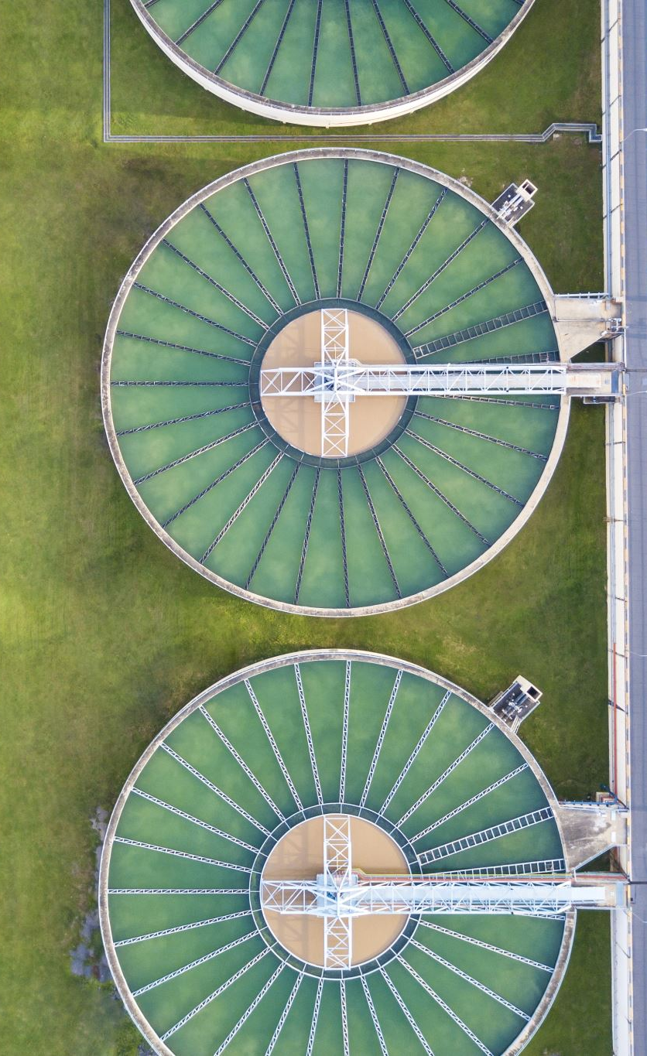
METRIC SELECTION
ANY QUANTITY THAT CAN BE MEASURED AT RUN-TIME AND LIKELY TO BE AFFECTED WHEN INTERFERENCE OCCURS
WHEN TANK GETS FULL, THE WATER WILL OVERFLOW WHICH CAN BE SAFELY REDIRECTED
WHEN TANK GETS EMPTY THOUGH, THE WATER PRESSURE IN THE DISTRIBUTION NETWORK DECREASES AND MAY EVENTUALLY STOP WATER SUPPLY TO HOMES AND BUSINESSES.
IN EMERGENGY SUCH AS HOUSE FIRE THERE WILL NOT BE ENOUGH WATER AVAILABLE
OVERALL -> CATASTROPHICAL CONSEQUENCES!
EMPTY TANK SITUATION MUST BE AVOIDED

Slide 24
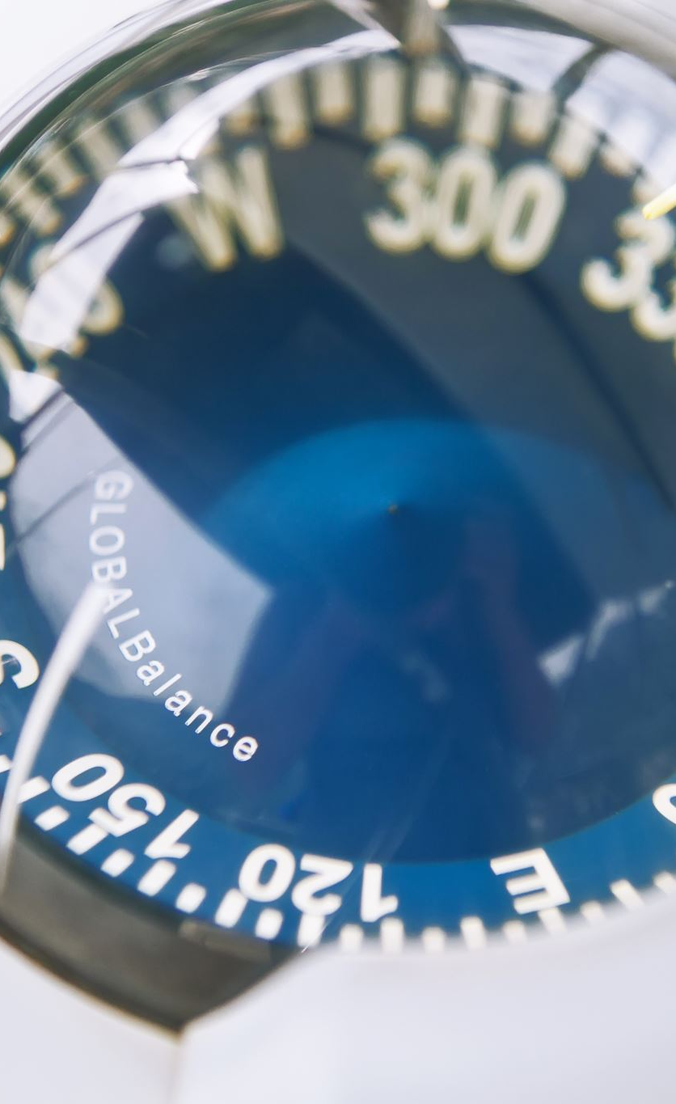
METRIC SELECTION
IN WATER TOWER SYSTEM, THE QUANTITY THAT WILL MOST LIKELY BE AFFECTED DUE TO FAULTY SENSOR READING IS THE WATER LEVEL.
DUE TO VARYING WATER DEMAND AND CONTROLLER ACTIONS, THE WATER LEVEL FLUCTUATES THROUGHOUT THE DAY.
WHEN WATER LEVEL GETS LOW, CONTROLLER STARTS FILLING THE TANK.
IN ORDER TO IMPLEMENT SAFETY-NET USING PERFORMANCE COUNTER, WE CAN THEN MEASURE THE TIME WATER LEVEL STAYS BELOW A CERTAIN LEVEL BEFORE RISING BACK AGAIN.
IF INTERFERENCE OCCURS PREVENTING CONTROLLER FROM DETECTING LOW WATER LEVEL, THIS SHOULD RESULT IN LONGER TIME FOR THE WATER LEVEL TO RISE BACK.

Slide 25

METRIC CHARACTERIZATION
SINCE THE TASK ACTIVATIONS HAVE BEEN SYNCHRONIZED USING TIMERS, ALMOST EXACT WORKING CAN BE SIMULATED IN MATLAB.

Slide 26
METRIC CHARACTERIZATION
10000 DAYS SIMULATION
RIGHT:
X: Time taken to rise back above threshold
Y: Number of occurrences
LEFT: fitted to gamma pdf

Slide 27

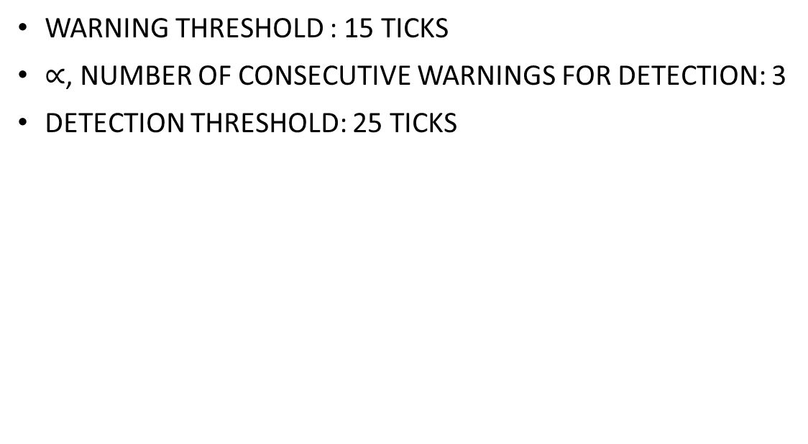
THRESHOLD DETERMINATION
WARNING THRESHOLD : 15 TICKS
$∝$, NUMBER OF CONSECUTIVE WARNINGS FOR DETECTION: 3
DETECTION THRESHOLD: 25 TICKS

Slide 28

ONLINE DETECTION
IN THE DETECTOR TASK
START TIMING TICKS EVERYTIME THE WATER-LEVEL FALLS BELOW LOW WATER LEVEL THRESHOLD.
WE CAN SAY, IT IS MONITORING A FLOAT SWITCH THAT CHANGES STATE WHEN FLOATING VS WHEN NO WATER TO FLOAT
NO FAULTY SENSOR READING INTERFERANCE ON THE DETECTOR

Slide 29

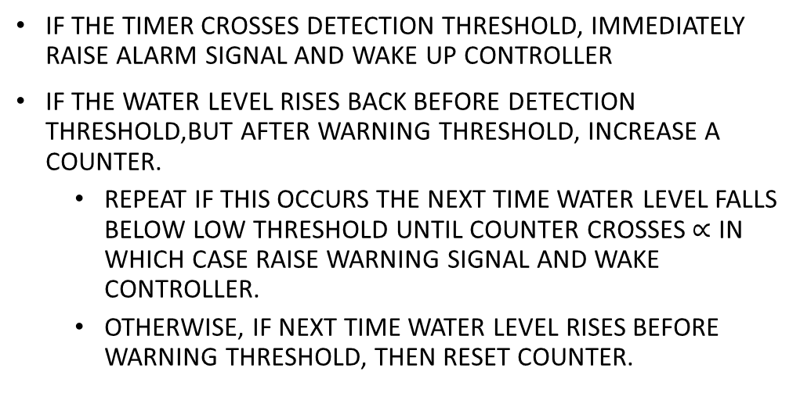
ONLINE DETECTION
IF THE TIMER CROSSES DETECTION THRESHOLD, IMMEDIATELY RAISE ALARM SIGNAL AND WAKE UP CONTROLLER
IF THE WATER LEVEL RISES BACK BEFORE DETECTION THRESHOLD,BUT AFTER WARNING THRESHOLD, INCREASE A COUNTER.
REPEAT IF THIS OCCURS THE NEXT TIME WATER LEVEL FALLS BELOW LOW THRESHOLD UNTIL COUNTER CROSSES $∝$ IN WHICH CASE RAISE WARNING SIGNAL AND WAKE CONTROLLER.
OTHERWISE, IF NEXT TIME WATER LEVEL RISES BEFORE WARNING THRESHOLD, THEN RESET COUNTER.

Slide 30
RECOVERY
IN CONTROLLER TASK
NORMAL MODE:
WHEN NO SIGNAL IS RAISED BY DETECTOR
OPEN IN-VALVE WHEN SENSOR READING IS LOWER THAN LOW WATER THRESHOLD
CLOSE IN-VALVE WHEN SENSOR READING IS HIGHER THAN HIGH WATER THRESHOLD

Slide 31
RECOVERY
GRACEFUL DEGRADATION:
WHEN WARNING SIGNAL RAISED BY DETECTOR
SCHEDULE CHANGE
CONTROLLER RESTARTS SENSOR, WAITS AND IMMEDIATELY READS THE SENSOR VALUE AND THEN AFTER CONTROLLING THE VALVES SAME WAY AS IN NORMAL MODE, PERFORMS OTHER TASKS.
RETURN TO NORMAL MODE, WHEN THE DETECTOR SIGNALS THAT WATER LEVEL HAS RISEN ABOVE LOW THRESHOLD

Slide 32
RECOVERY
HARD RECOVERY:
WHEN ALARM SIGNAL IS RAISED BY DETECTOR
RESTART SENSOR AND READ IMMEDIATELY LIKE IN GRACEFUL DEGRADATION
INCREASE IN-FLOW PUMP RATE BY 20% AND LIMIT PEAK OUT-FLOW TO THE NEW-INFLOW RATE
WATER LEVEL EITHER CONSTANT OR INCREASES
RETURN TO NORMAL MODE, WHEN THE DETECTOR SIGNALS THAT WATER LEVEL HAS RISEN ABOVE LOW THRESHOLD

Slide 33
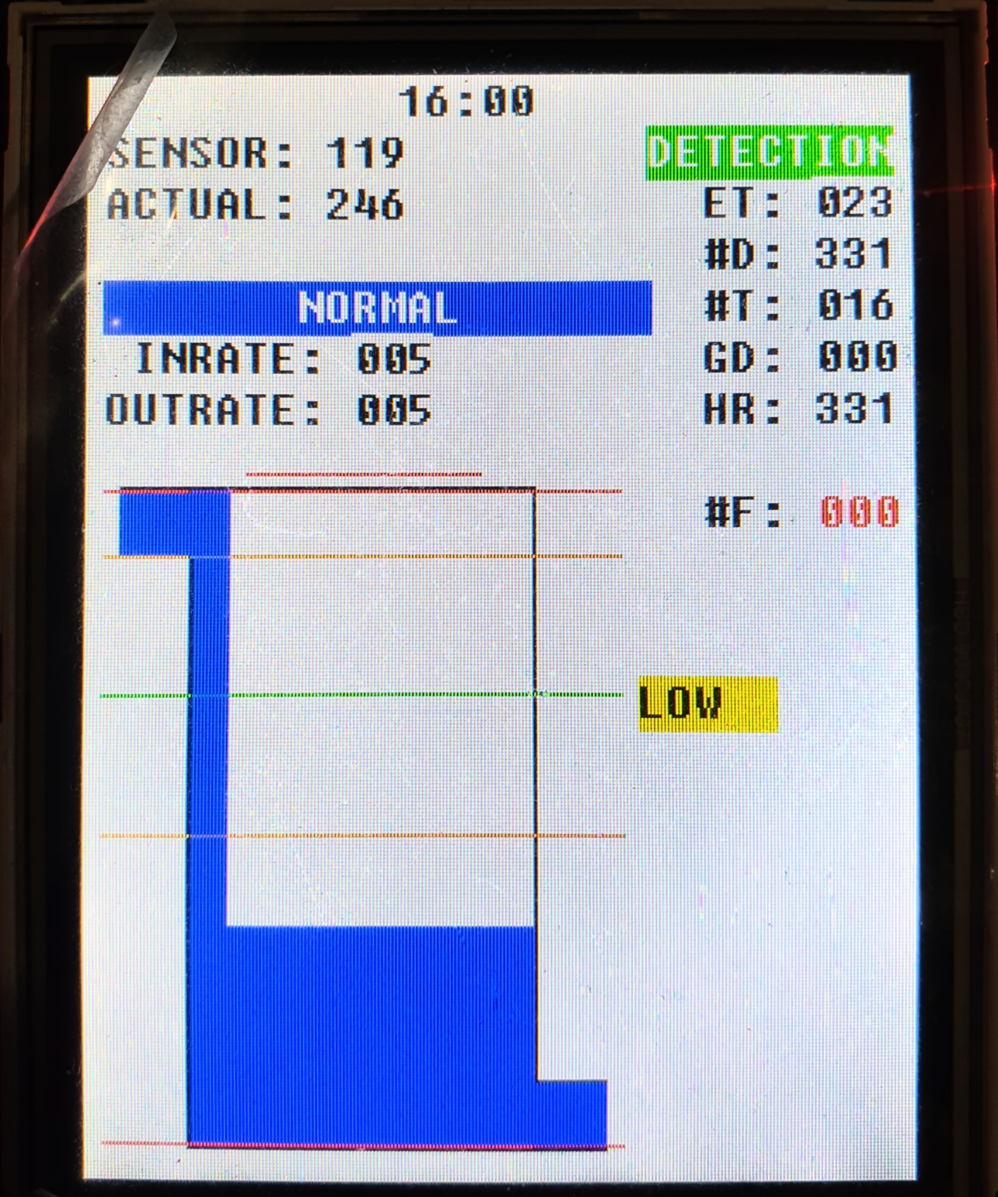
RESULT AFTER ~30 MIN RUN WITH FAULT INJECTION
#INTERFERENCE DETECTED: 331
#POTENTIAL INTERFERENCE TOLERATED: 016
#GRACEFUL DEGREDATION: 0
#HARD RECOVERY: 331
#TANK EMPTIED: 0

Slide 34
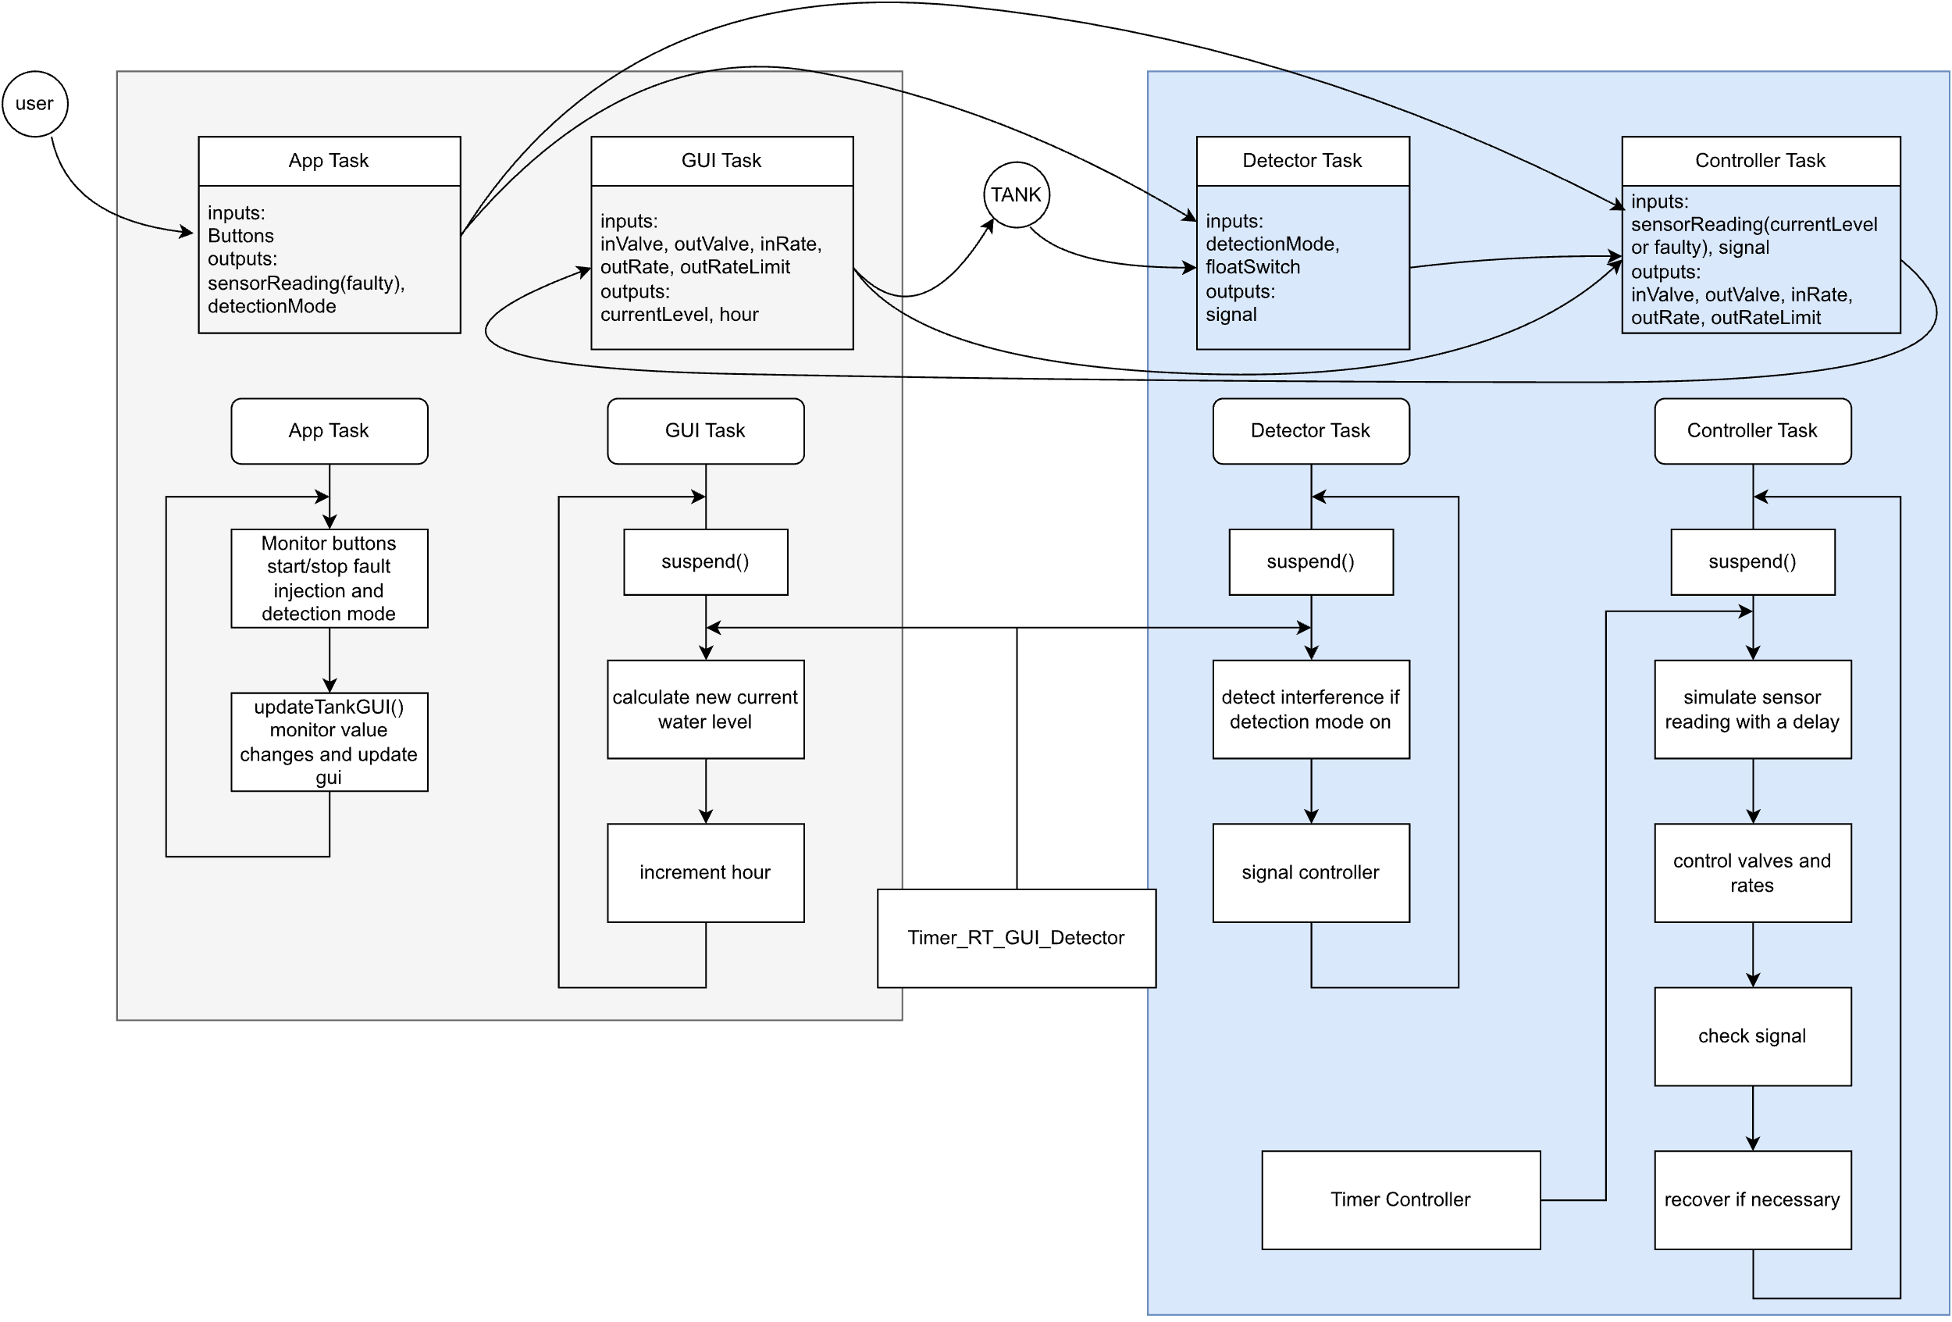
DIY
Tank is independent and provides interface (variables) for the microcontroller
Can implement your own controller and detector using the input and output variables available for the tasks.
Template and configuration files are provided

Slide 35



PROJECT 6 REAL-TIME SAFETY AND FAULT INJECTION: LAB DEMONSTRATION
BY: ANDREAS SANDSMARK BAKKE, BIPIN THAPA, HEBA MAHMOUD MOHAMED EMAD HASSAN
This work is licensed under the Creative Commons Attribution-NonCommercial 4.0 International License. To view a copy of this license, visit http://creativecommons.org/licenses/by-nc/4.0/ or send a letter to Creative Commons, PO Box 1866, Mountain View, CA 94042, USA.
"This material was originally developed as part of an assignment of the Operating systems for embedded systems course delivered at Politecnico di Torino by Prof. Stefano Di Carlo".

Slide 36

Thank you

